Slide 1
INTERNSHIP

Slide 2

DABOTICS
DABOTICS INDIA PRIVATE LIMITED is a Private Limited Company, incorporated under the Companies Act as a Company limited by shares. It is classified as Non-government company and is registered at RoC-Kanpur.
Company was founded in 2022 by SACHIN SRIVASTAV and PRANJAL SHRIVASTAVA.
There are 3 promoter(s) of the company viz :-
Sachin Srivastav
Pranjal Shrivastava
Sudhir Kumar Gupta.

Slide 3
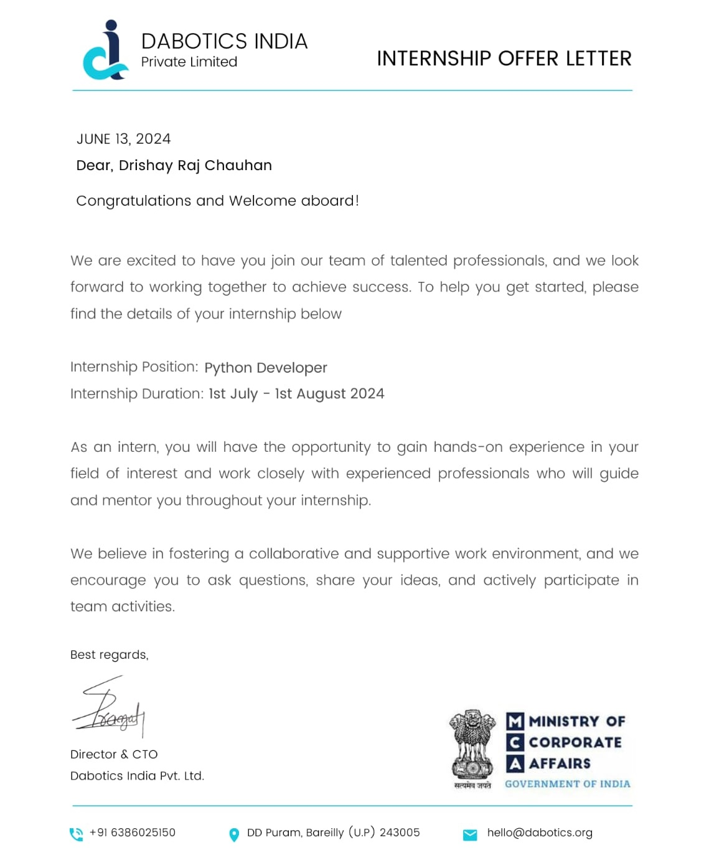
INTERNSHIP - Process
The process began with completing a Google form for the Dabotics internship to receive an offer letter. I learned about Dabotics through a friend, and the internship commenced on July 1st.
Role: Python Developer Intern
Duration: 1 month (July, 4 weeks)

Slide 4
Tasks
We were assigned four tasks over four weeks (one task per week) and were required to submit our task code along with a preview at the end of each week.
The tasks were:
Week 1
Task 1 Build an Alarm Clock.
Week 2
Task 2 OTP Verification using Python
Week 3
Task 3 URL Shortener with Python
Week 4
Task 4 Build your own Chatbot
Week 1
Week 2
Week 4
Week 3

Slide 5
Task - 1
The objective of our project is to implement an alarm clock using Python. Python consists of some very innovative libraries such as datetime and tkinter which help us to build the project using the current date and time as well as to provide a user interface to set the alarm according to the requirement in 24-hour format.

Slide 6
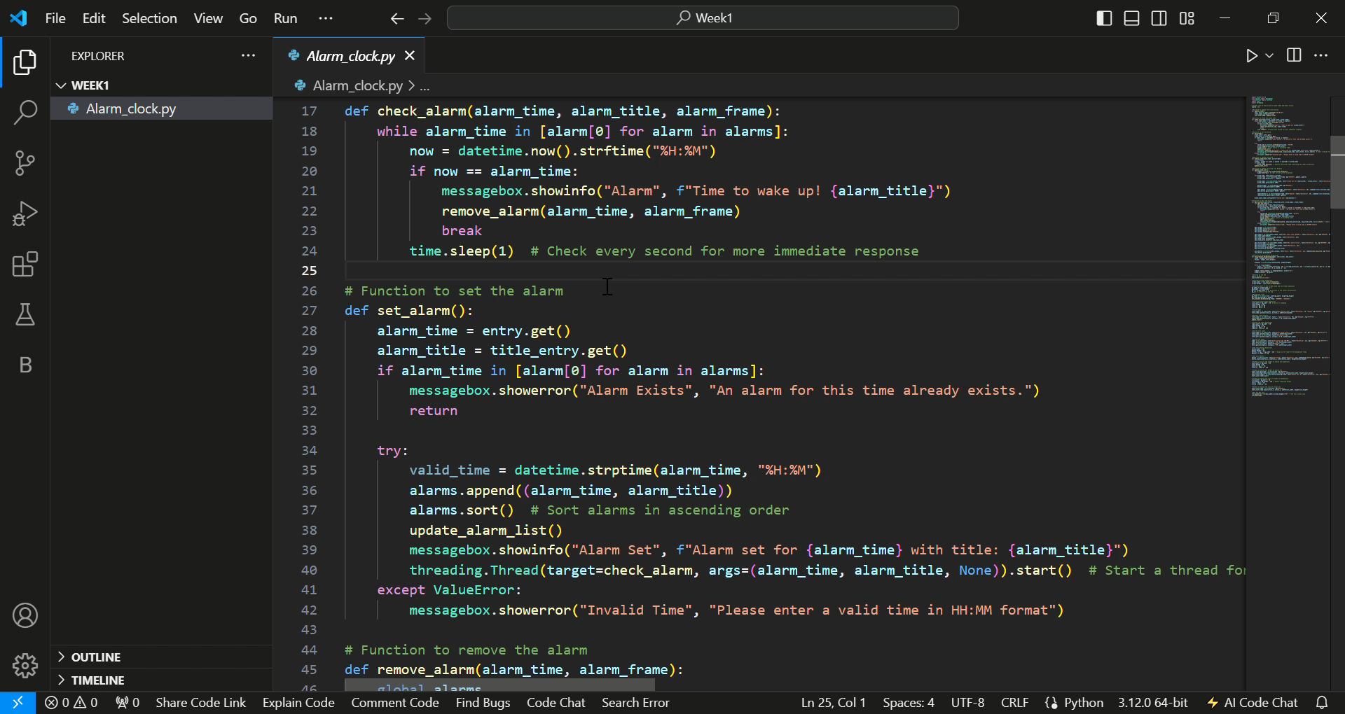
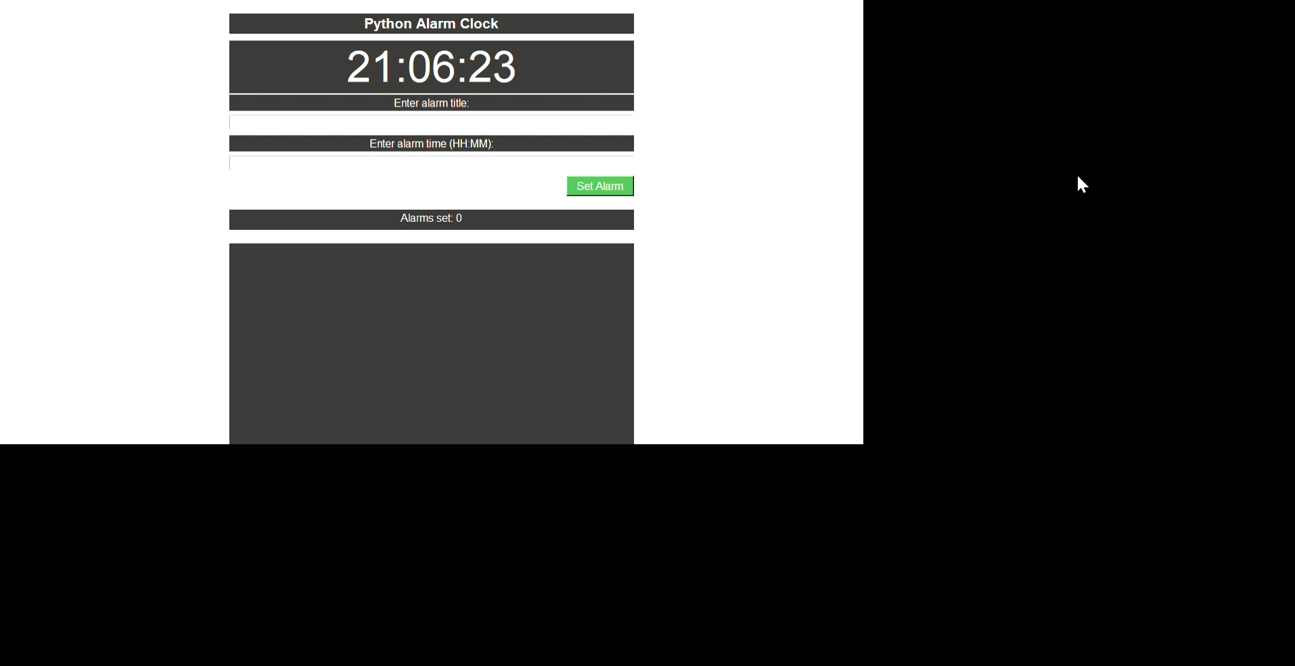
Task - 1

Slide 7
Task - 2
OTP Verification is the process of verifying a user by sending a unique password so that the user can be verified before completing a registration or payment process. Most of the time, we get an OTP when we make an online payment, or when we forget our password, or when creating an account on any online platform. Thus, the sole purpose of an OTP is to verify the identity of a user by sending a unique password.
We can easily create an application for the task of OTP verification using Python by following the steps mentioned below:
First, create a 6-digit random number.
Then store the number in a variable
Then we need to write a program to send emails.
When sending email, we need to use OTP as a message.
Finally, we need to request two user inputs; first for the user’s email and then for the OTP that the user has received.
So this is the complete process of creating an OTP verification application using Python.

Slide 8
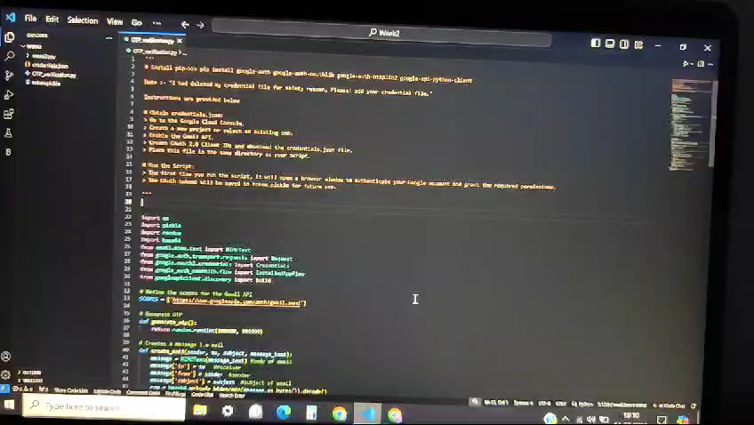
Task – 2

Slide 9
Task - 3
You must have used various online URL shortening services and they all are doing a great job as well! Even Google forms also use shorten URLs for ease of use. So it’s a widely used service on the Internet. Have you ever thought about or tried to shorten the length of the URL? Hopefully, there are plenty of libraries and APIs available in the Python programming language to help us do the same using programming

Slide 10
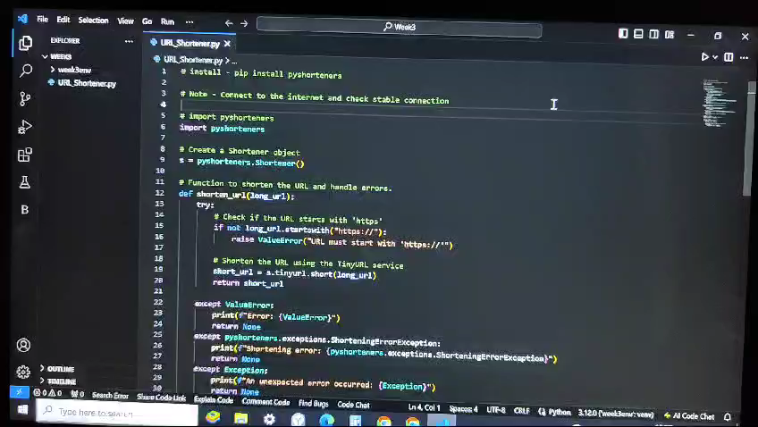
Task – 3

Slide 11
Task - 4
A chatbot is a piece of software that mimics human dialogue through text chats, voice commands, or both. Here are the 9 steps you will cover to help you get a chatbot :
Decide what type of chatbot is best for you.
Determine your chatbot key performance indicator.
Understand user needs.
Give your chatbot a personality.
Plan your chatbot flow.
Design your chatbot.
Preview and test your chatbot.
Target your chatbot.
Measure and optimize chatbot performance.

Slide 12
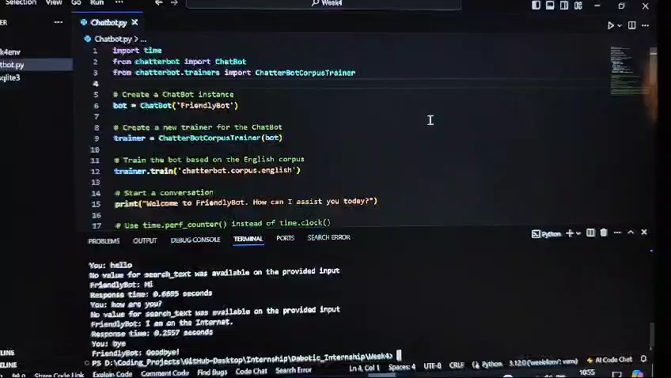
Task – 4

Slide 13







Resources
Google - https://www.google.co.in/
Python Docs - https://docs.python.org/3/
GeeksforGeeks - https://www.geeksforgeeks.org/
StackOverflow - https://stackoverflow.com/
Quora - https://www.quora.com/
YouTube - https://www.youtube.com/
Tkinter Document - https://docs.python.org/3/library/tk.html
Google Cloud Console - https://console.cloud.google.com/welcome/new
ChatGPT - https://chatgpt.com/
Please note that while I have listed 8-9 key resources, there were several additional resources that contributed to the completion of these tasks.

Slide 14
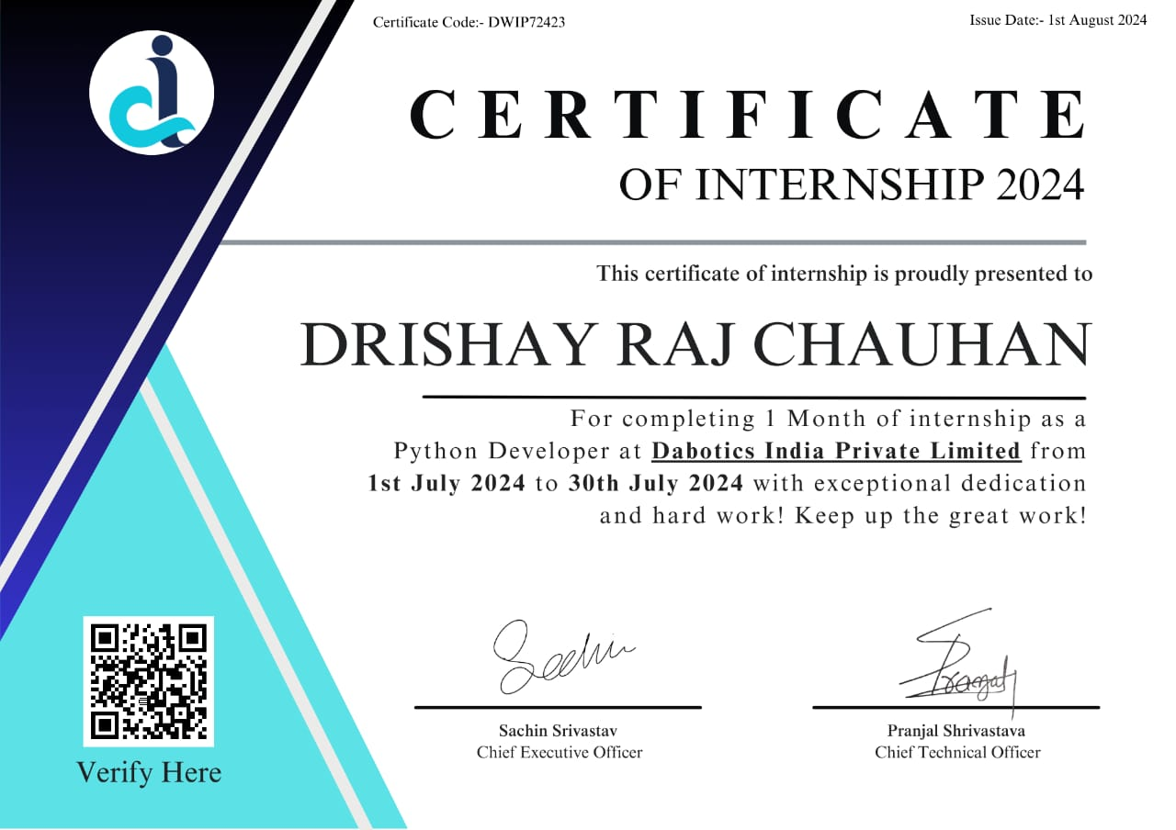
CERTIFICATE
Connect with Me☺
LinkedIn
GitHub
Dabotics

Slide 15
THANK YOU
I sincerely appreciate the opportunity to intern here. Through this internship, I have significantly sharpened my Python skills and feel more motivated and committed to pursuing my development goals. Please Note: The logos used in this presentation are copyrighted and have been used solely for educational purposes. All rights are reserved by the respective companies. Copyright is a legal right.

